Slide 1
Module 12
Pricing Decisions
By: Dr Shahinaz Abdellatif

Slide 2
Objectives of the Session
1. To understand the price setting process
2.To examine cost oriented, competition oriented and customer oriented pricing methods

Slide 3
The Price-setting Decision Process
Set strategic
pricing objective
Influences and constraints
SBU and marketing strategies
Target market characteristics
Product characteristics
Competitor characteristics
Company strengths and
weaknesses
Environmental influences
Economic trends
Legal restrictions
Estimate demand
and price elasticity demand
Determine costs and their
relationships to volume
Examine competitors’ prices
and cost
Select a method for
calculating price
Set a price level
Adapt price structure to meet variations in demand and cost across geographic territories, market segments, etc.

Slide 4
Strategic Pricing Objectives
Maximise sales growth – penetration pricing
Maintain differentiation
Maximise current profit – skimming
Subsidising pricing

Slide 5
1- Maximise sales growth & Penetration
When a firm is an early entrant into a new product-market with the potential for substantial growth, its objective may be to maximise its product’s rate of sales growth (in units).
This suggests it should set a relatively low price to attract as many new customers as quickly as possible and to capture a large share of the total market before it becomes crowded with competitors. This low-priced strategy is called penetration pricing.

Slide 6
Penetration Pricing
Penetration pricing is appropriate when, in addition to a large market:
1. Target customers are relatively sensitive to price.
2. The firm’s costs are low compared to competitors’ and the SBU is pursuing a low-cost strategy.
3. Production and distribution costs per unit are likely to fall substantially with increasing volume.
4. Low prices may discourage potential competitors from entering the market.

Slide 7
2- Maintain Quality or Service Differentiation
When a firm has a strong competitive position based on superior product quality or customer service, its primary pricing objective is to generate sufficient revenue to maintain that advantage.
Such a firm usually asks a premium price for its product for two reasons:
First, it needs additional revenue to cover the R&D, production, distribution, and advertising costs it takes to maintain both the reality and the perception of superior quality or service.

Slide 8
2- Maintain Quality or Service Differentiation
Second, customers are usually willing to pay more for a superior offering; high quality decreases the elasticity of demand.
A premium price policy is most appropriate for businesses pursuing differentiated defender strategies

Slide 9
3- Maximize Current Profit
When firms pioneer the development of a new product-market, sometimes their pricing objective is to maximise short-run profits. They adopt a skimming price policy, setting the price very high and appealing to only the least price-sensitive segment of potential customers.
Skimming is most relevant to a small market & appropriate for businesses pursuing prospector strategies involving investments in the development and commercialisation of a stream of new products with proprietary technology.

Slide 10
3- Maximize Current Profit
At the other end of the life cycle, some product-markets decline rapidly as customer preferences change or new technologies and substitute products are introduced.
Firms facing this situation adopt a harvesting strategy to maximise short-term profits before demand for the product disappears. This typically involves cutting marketing, production, and operating costs of the product, while setting a high price to maintain margins and maximise profits.
This is an appropriate strategy only where there is no way – such as by making product improvements or increasing promotion – to sustain market demand or the item’s competitive position very far into the future.

Slide 11
3- Maximize Current Profit
Businesses with an established product in a market expected to grow or experience stable demand well into the future run into trouble because of strategic mistakes, such as failing to adapt to customers’ changing desires or to competitive threats, or building excess capacity.
If such mistakes are correctable, the firm may adopt a pricing objective of Survival, i.e. simply keeping the product alive while strategic adjustments are made.

Slide 12
4- Social Objectives
Some organisations may forgo possible profits – at least among some price-sensitive customer segments – by offering a low price to those customers to achieve some broader social purpose.
This is most common among not-for-profit organisations such as performing arts organisations and public hospitals, especially if subsidised by government agencies, foundations, or private contributions and not relying on sales as their sole source of revenue.

Slide 13
Estimating Demand and Perceived Value
Demand sets the ceiling on the range of feasible prices for a product. The familiar demand curve depicts this variation in the quantity demanded at different prices. In most cases there is an inverse relation between a product’s price and the quantity demanded: the higher the price, the less people want to buy. Thus, the typical demand curve has a negative, or downward, slope.
However, luxurious products and those whose quality is difficult to objectively judge sometimes have positively sloping demand curves. Some customers use price as an indicator of the prestige or quality of such products, and they are induced to buy more as the price increases.

Slide 14
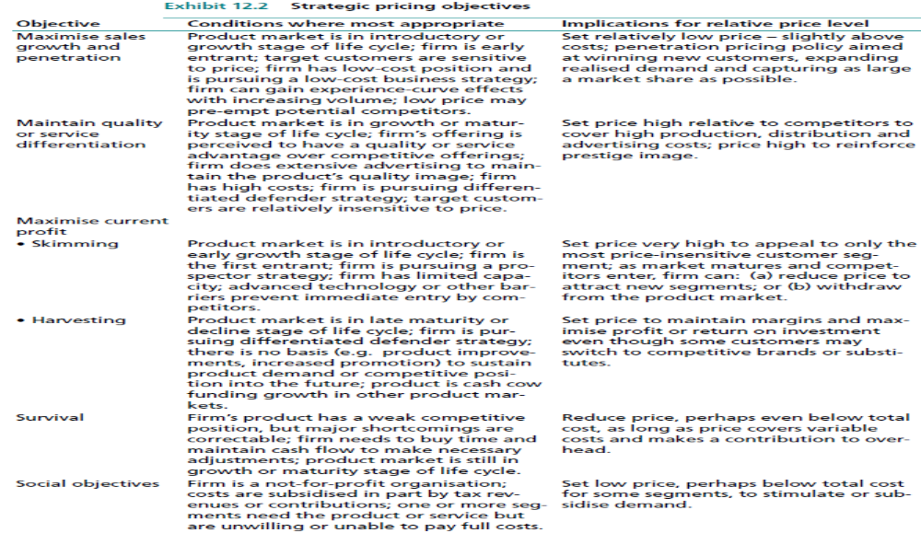

Slide 15
Factors Affecting Customer Sensitivity to Price
Unique value effect
Price-quality effect
Degree of necessity
Buyers’ relative knowledge of the market
Buyers ability to pay
Importance of time

Slide 16
Price Elasticity
Graph to illustrate the price elasticity of
demand in a market
P0
Relatively price-inelastic
demand curve
Price
P1
0 Q0 Q1 Q demanded

Slide 17
Price Elasticity of Demand
Price elasticity of demand (E) =
Per cent change in quantity demanded
Per cent change in price

Slide 18
Estimating Costs
Fixed Costs (or overhead) - constant in the short-term, regardless of production volume or sales revenue
Variable Costs – vary directly in line with the level of production
Total Costs = FC + VC

Slide 19
Cost-oriented Pricing – Approach 1 Cost Plus Pricing
Popular pricing method
Add a mark-up to the cost of the product – cost plus or mark up
Unit cost = VC + FC/expected unit sales
Doesn’t consider price sensitivity of demand or pricing practices of competitors

Slide 20

Break even point

Slide 21
Break-even Analysis
Technique that brings out cost-volume-profit interplay
Example:
Fixed Costs - £12,000
Variable Costs = £6 per unit
Selling Price = £10 per unit
How many units to break-even?

Slide 22
Break-even
No. of units to break-even = FC/Contribution per unit
= £12,000/£4 per unit
= 3,000 units
Check:
Sales (£) = £30,000 (3,000 x £10)
VC = £18,000 (£6 x 3,000)
FC = £12,000
TC = £30,000 /£10 = 3,000 units

Slide 23
Break-Even Chart Showing Break-Even and Target Return Volume
1,500
1,250
1,000
750
500
250
0
Total revenue
Total costs
Target
return
Dollars ($000)
10 20 30 40 50
Break-even
volume
Target
return
volume
Sales volume in units (000)
Notes:
3
Note how a small change in price can significantly influence both the break-even point and the level of unit sales at which the target return is achieved.

Slide 24
Cost-oriented Pricing (Approaches 2-3) - Rate of Return and Payback
Brings cost of capital into the pricing decision
Objective – to set a price yielding target rate of return on investment
The first method used is target rate of return
The second method used is Payback method-
i.e. decide time required to pay back original investment

Slide 25
Target return price

Slide 26
Competition Oriented Methods
Going rate or competitive parity v leader pricing
Price reflects common industry price structure designed to achieve a fair return
Often found in mature industries
Little product differentiation
Avoidance of price war
Focus on controlling costs to achieve adequate returns
Others: Competitive bidding (auction sites)

Slide 27
Customer Oriented Pricing
Pricing to capture value perceived by the customer, not costs
  Cost oriented methods can lead to pricing lower than perceived value “leaving money on the table”
Requires customer research

Slide 28
Customer Oriented Pricing
Value-in-use
Pricing lining (or team pricing)
Psychological pricing
Promotional pricing

Slide 29
Differential Pricing
Differential pricing occurs when a firm sells a product or service at two or more prices not determined by proportional differences in cost.
This is usually done to adjust to differences in the price sensitivities or preferences of various customer segments.

Slide 30
Differential Pricing
Time pricing
Location pricing
Customer segment pricing

